Slide 1
Customer Retention
Flip Robo Technologies
Submitted By:
Sarika Thorat

Slide 2
Introduction
Problem Statement
Problem Understanding
EDA Steps
Visualizations
Observation

Slide 3
INTRODUCTION
Nowadays, online shopping is a fast-growing phenomenon. Growing numbers of consumers shop online to purchase goods and services, gather product information or even browse for enjoyment. Online shopping environments are therefore playing an increasing role in the overall relationship between marketers and their consumers.
In this presentation we will be looking at the analysis made on the customer retention rate for Indian e-commerce companies.
We will be analysing the customers retention rate and e-commerce success rate with the help of a survey answered by the customers on online retail companies and the factors that influence their purchase decision.
This analysis includes the expectations, reliability, trustworthiness etc of the customers on a good e-retailer store.

Slide 4
PROBLEM STATEMENT
Customer satisfaction has emerged as one of the most important factors that guarantee the success of online store; it has been posited as a key stimulant of purchase, repurchase intentions and customer loyalty.
A comprehensive review of the literature, theories and models have been carried out to propose the models for customer activation and customer retention.
Five major factors that contributed to the success of an e-commerce store have been identified as: service quality, system quality, information quality, trust and net benefit.
The research furthermore investigated the factors that influence the online customers repeat purchase intention.
The combination of both utilitarian value and hedonistic values are needed to affect the repeat purchase intention (loyalty) positively.
The data is collected from the Indian online shoppers. Results indicate the e-retail success factors, which are very much critical for customer satisfaction.

Slide 5
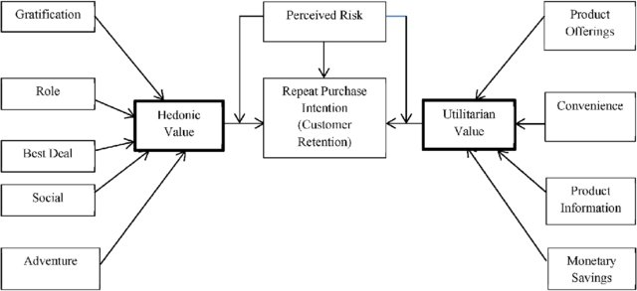
Utilitarian value: Utilitarian value is an objective value which provides some functional benefits to the consumers and helps consumers to accomplish practical tasks.
Hedonistic value: Hedonistic value is subjective (Psychological) value which provides an experiential satisfaction. In other words, the immediate psychological gratification that comes from experiencing some activity or from consumption of a product

Slide 6
Problem Understanding
How customers form expectations on technology
Five major factors that contributed to the success of an e-commerce store : service quality, system quality, information quality, trust and net benefit.
Customer retention is a simple concept, yet, it often requires effort from every department to improve the customer experience and build lasting trust.
So, what is customer retention and why it is so important. Let’s know about it by analysing the problem.

Slide 7
Data Analysis Steps Done
Import Libraries
Import Dataset
Data Preprocessing
Label Encoding & Conclusion
Visualization
(EDA)
Finding null values

Slide 8






Exploratory Data Analysis (EDA)
Requirements | Tools Used
Software | Programming language : Python Distribution : Anaconda Navigator Browser based language shell : Jupyter Notebook
Libraries/Packages | Pandas NumPy matplotlib seaborn scikit-learn

Slide 9
Shape : 269 rows and 71 columns.
No null values present.
70 categorical columns
1 numerical column
First I have imported the necessary libraries and loaded the entire dataset in our Jupyter Notebook and renamed the columns.
Then checked the shape of our dataset and found that we have a total of 269 rows and 71 different columns.
We don’t have any null values or missing values present in our dataset.
Date set has 1 numerical column and 70 categorical columns

Slide 10
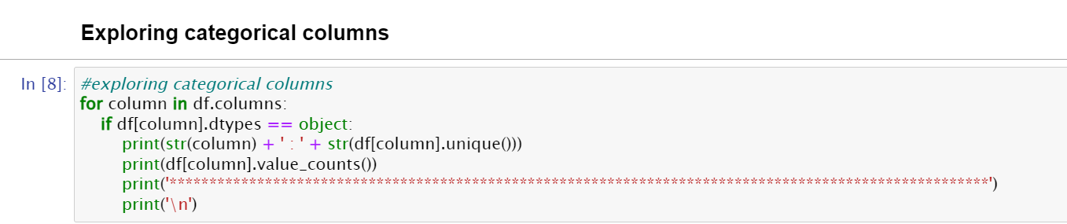
1 Gender of respondent :
Female 181
Male 88
2 How old are you? :
31-40 years 81
21-30 years 79
41-50 yaers 70
Less than 20 years 20
51 years and above 19

Slide 11
Exploring Categorical Columns

Slide 12
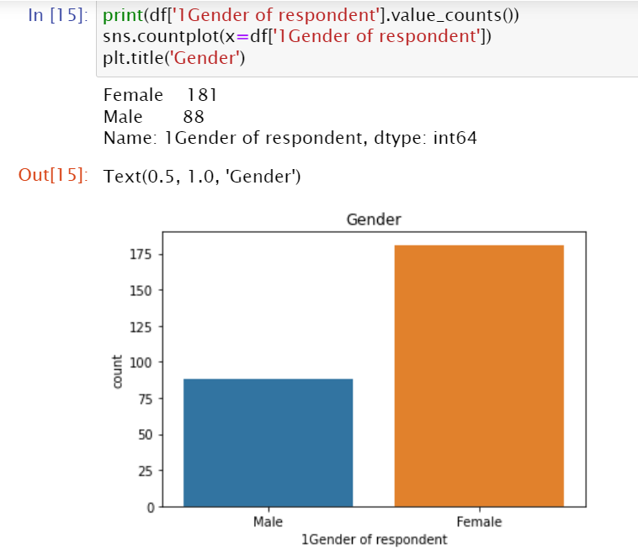
Data visualization
There are 50% more Females as compared to Males

Slide 13
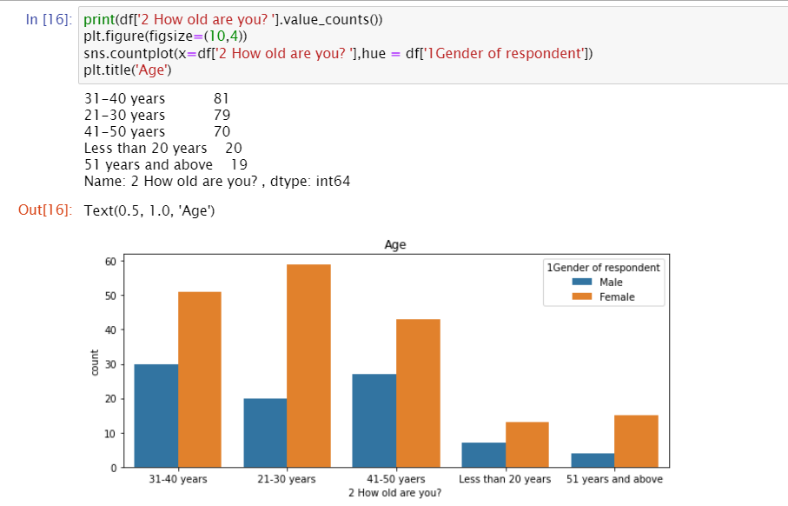
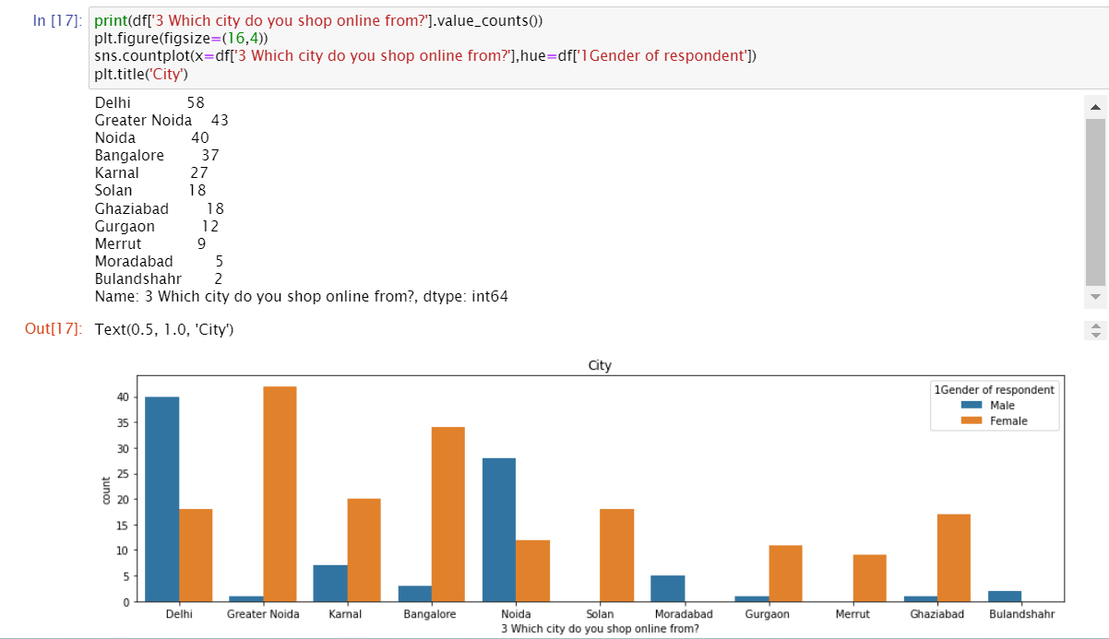

Slide 14
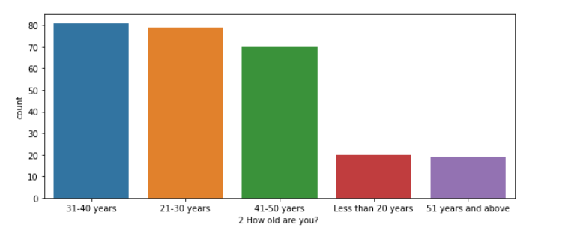
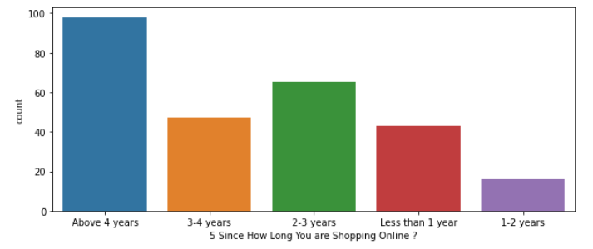
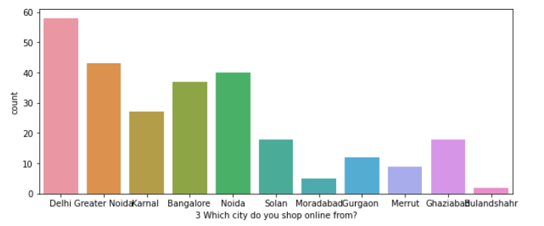
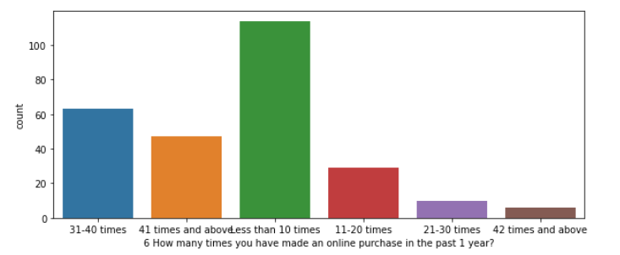
plot for all the categorical parameters

Slide 15
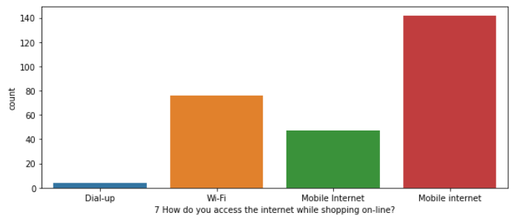
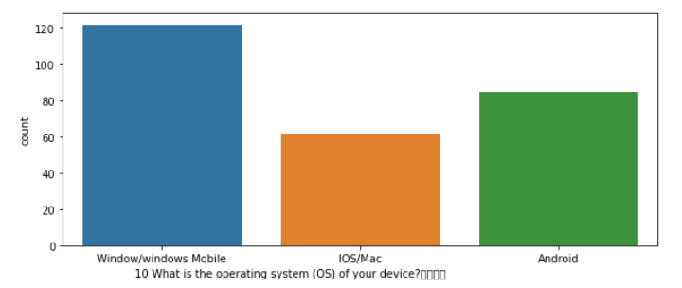
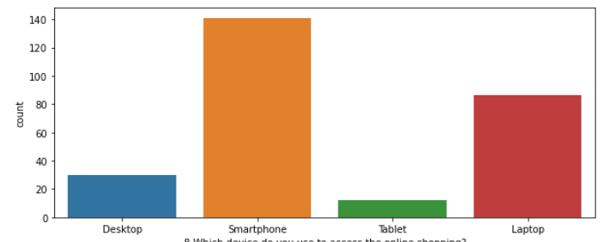
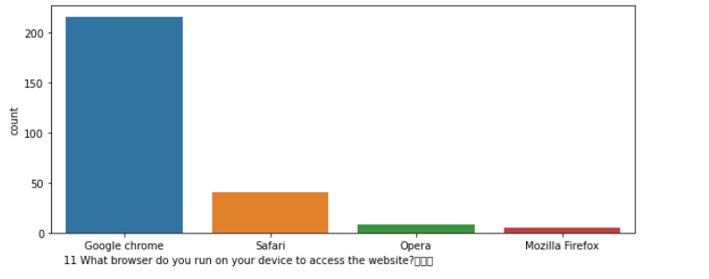
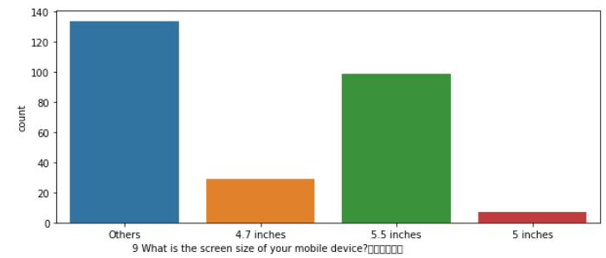
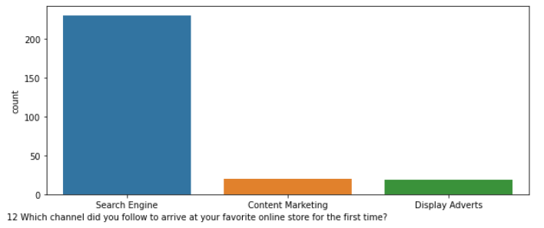

Slide 16
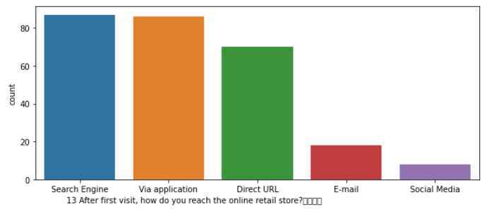
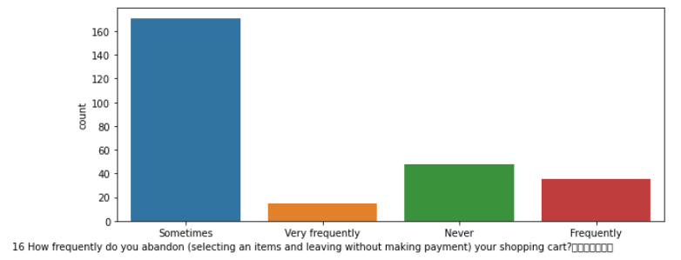
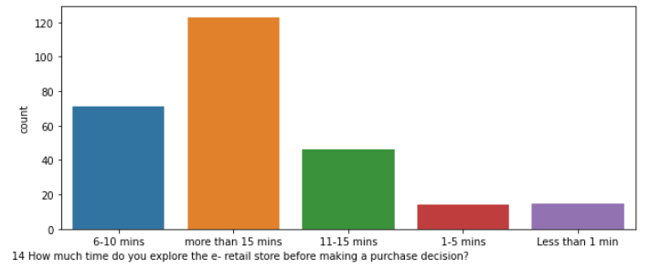
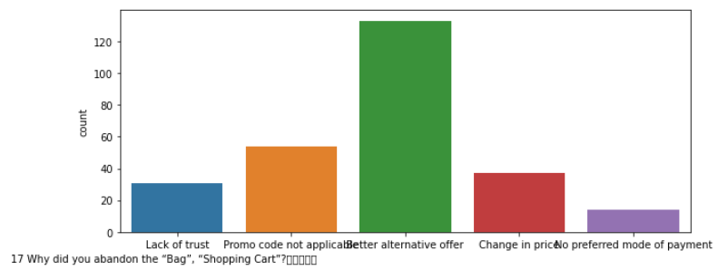
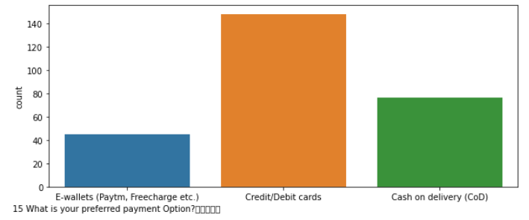

Slide 17
Conclusions :
Age: 85% of the people are within age group 20-50 years. Very small percentage of people are less than 20 or more than 50 years old.
Delhi, Greater Noida, Noida and Bangalore have the maximum participants.
Maximum number of participants have been using Online Shopping platforms for more than 4 years.
Purchases in last 1 year: Maximum People have made purchases less than 10 times. Next in line are 30-40 and 40+
Most people use Mobile internet during shopping on-line.
Very few people use desktops or tablets; while most are using Smartphones and laptops.
A large percentage of people use Google Chrome.
Search Engines are the most used channel which guide people to their favourite online store.
Most people take purchase decision after spending more than 15 minutes.
Credit/Debit cards are the most used mode of payment.
Maximum people abandon the items in cart 'sometimes' as opposed to never or frequently.
The biggest reason to abandon is 'Better alternative offer.

Slide 18
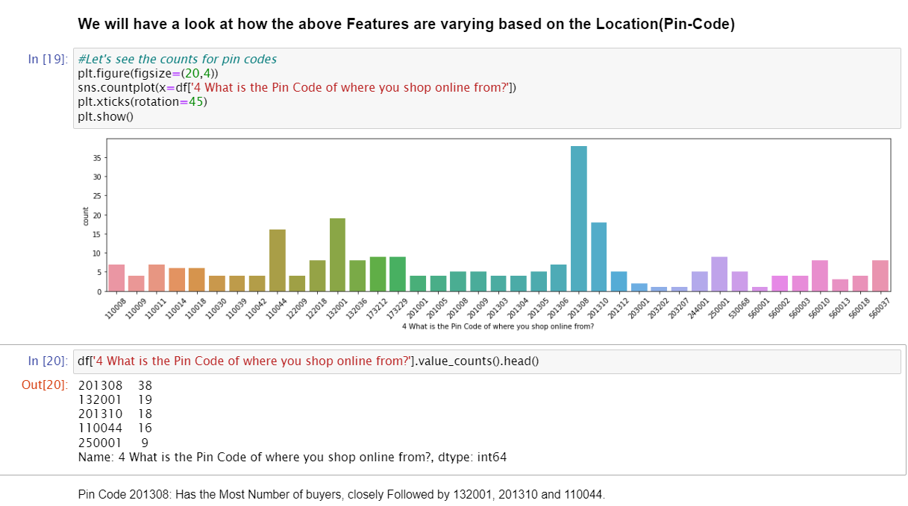

Slide 19
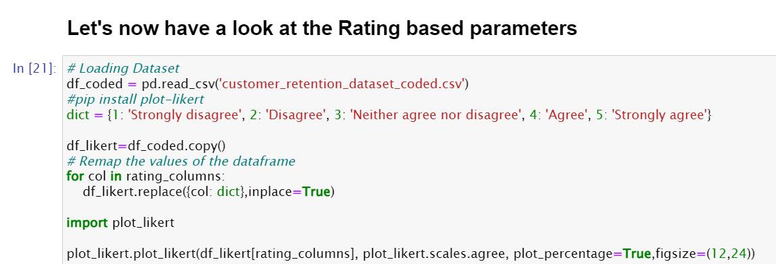

Slide 20
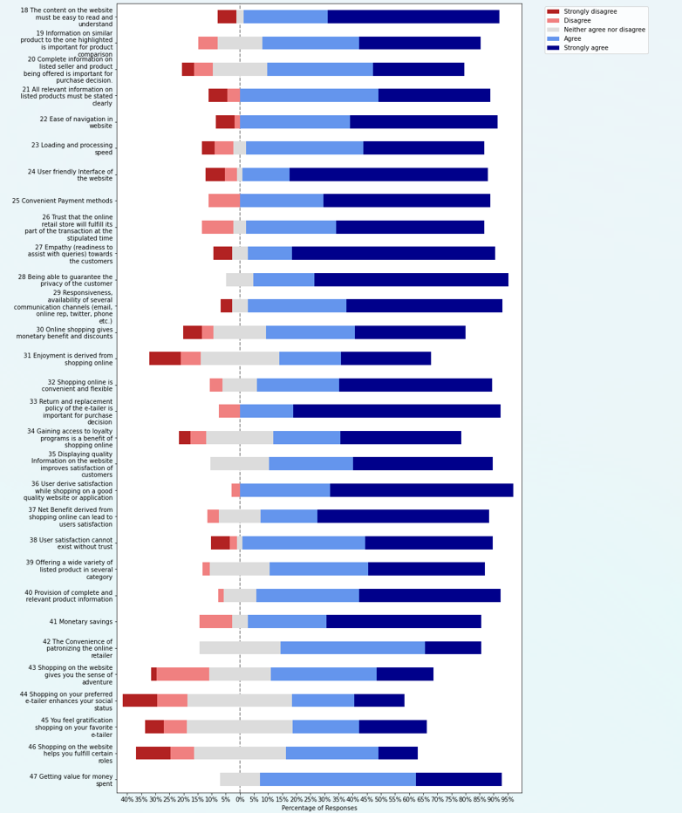

Slide 21
Observations on the basis of Customer's perception
A large majority of people believe that content on the website must be easy to read and understand.
People agree that Information on similar product to the one highlighted is important.
70% people believe that Complete information on listed seller and product is important for purchase decision.
90% people believe that All relevant information on listed products must be stated clearly
For more than 90% people, ease of navigation of website, loading or processing speed as well as User friendly Interface of the website is important.
Other important parameters are - Convinient Payment Methods, privacy of customers, responsiveness, availability of several Communication * channels, return and replacement policy.

Slide 22
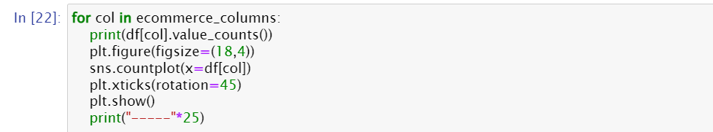
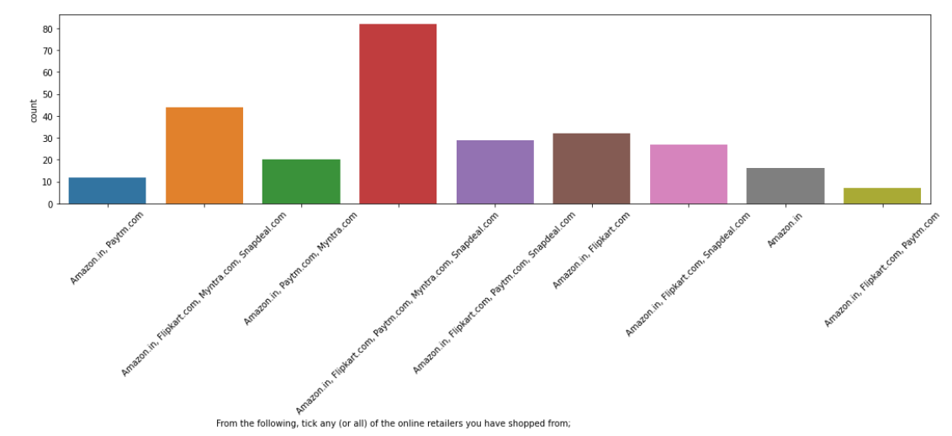
company name specific parameters

Slide 23
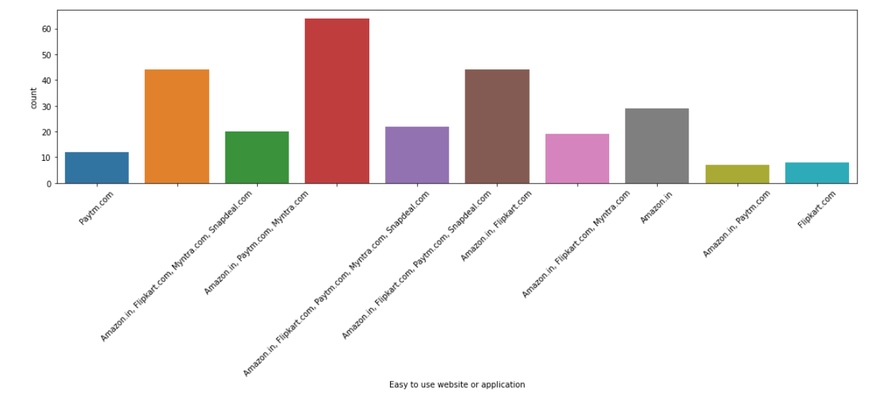
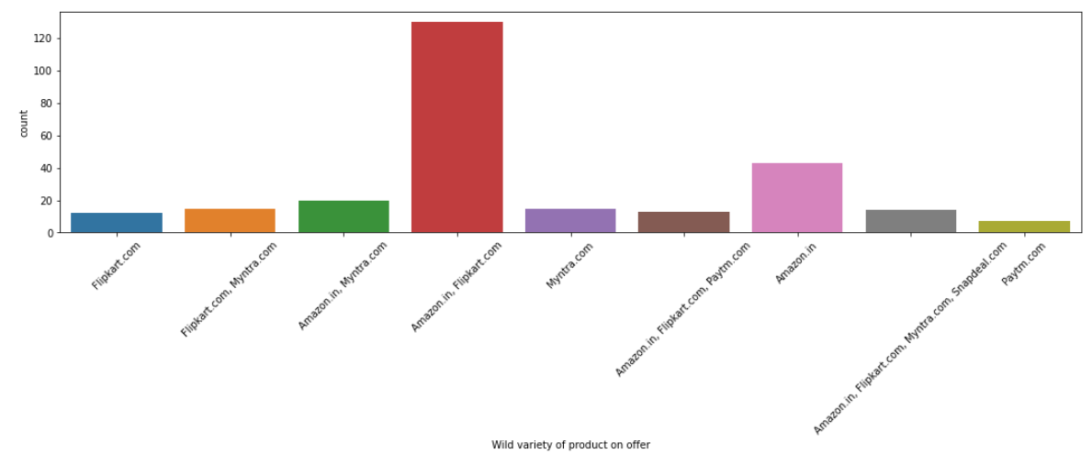
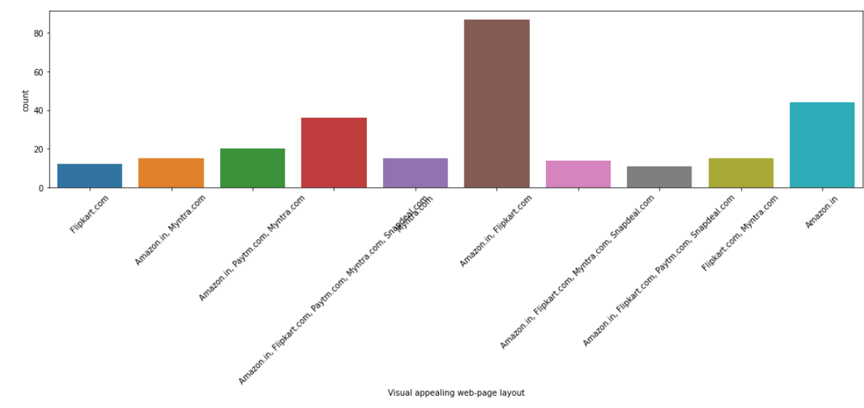
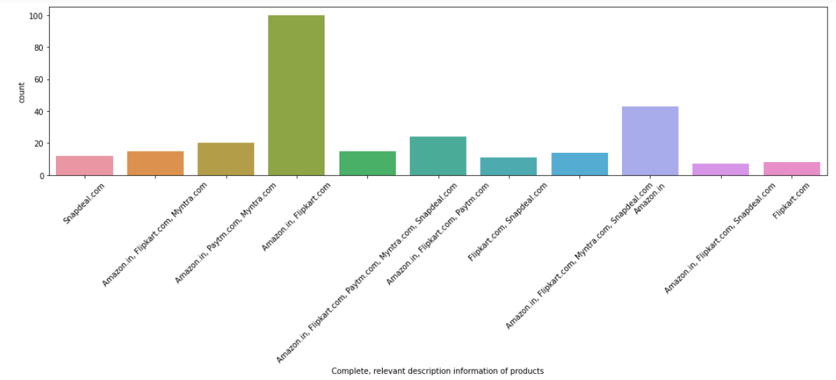

Slide 24
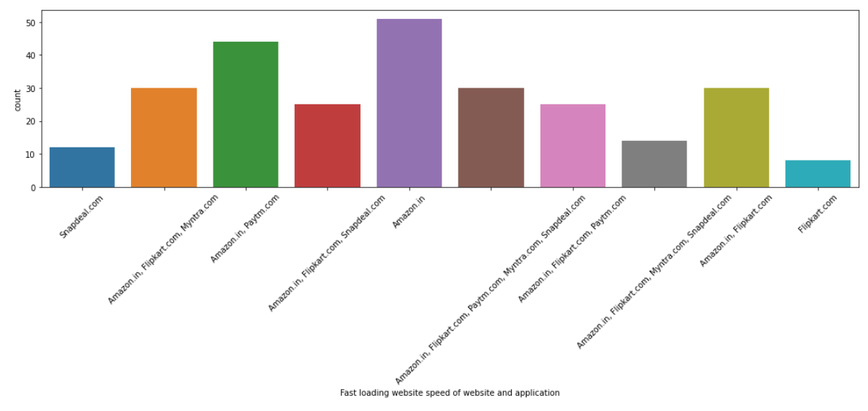
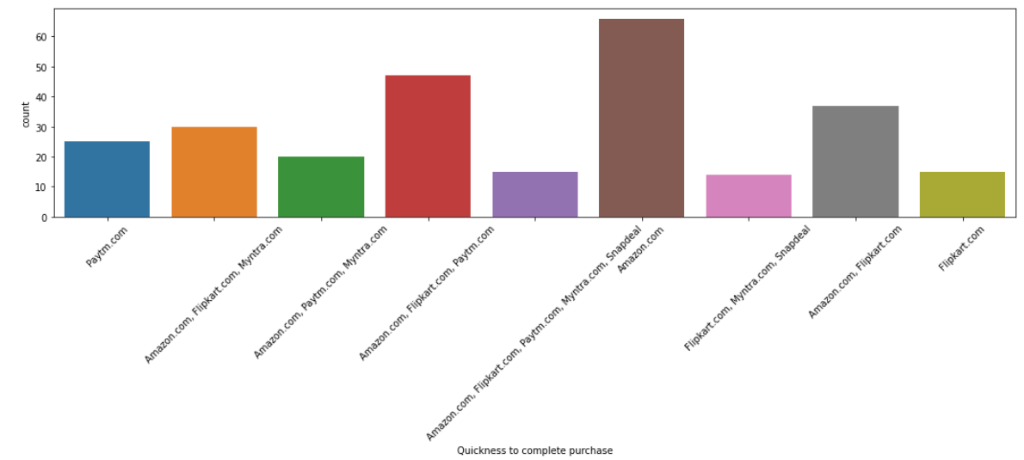
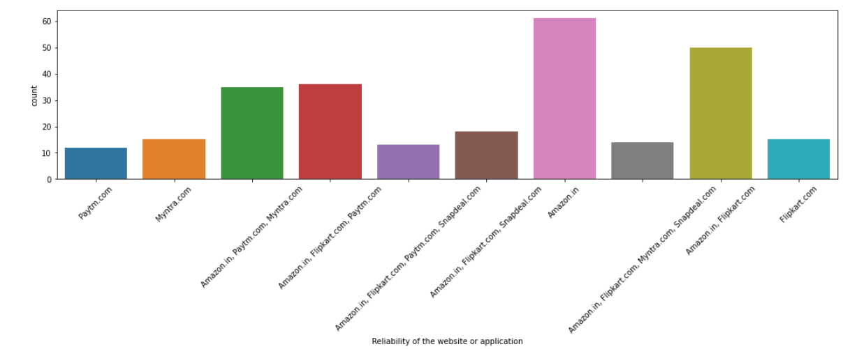
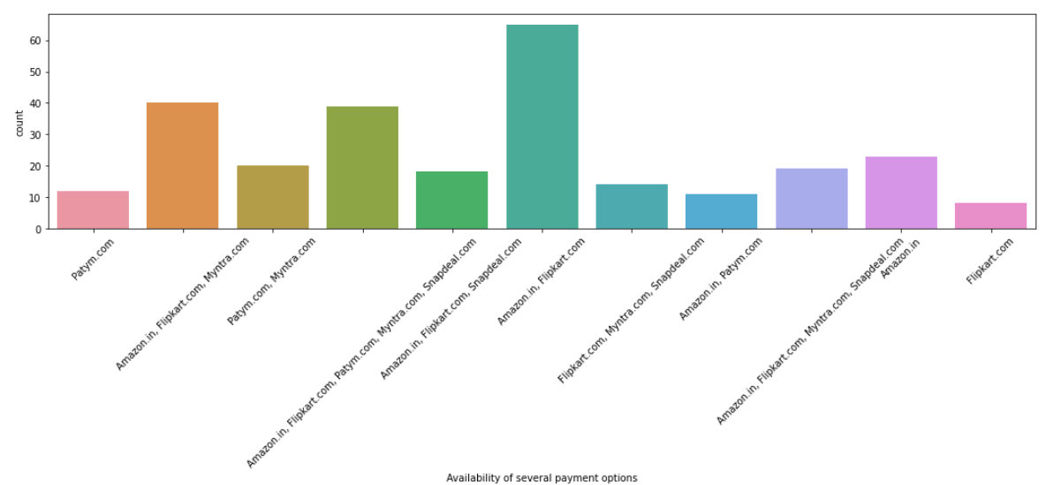

Slide 25
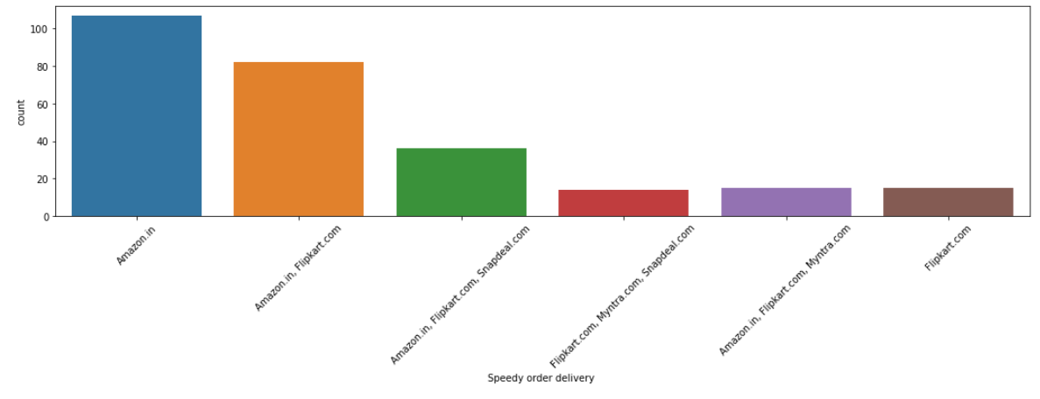
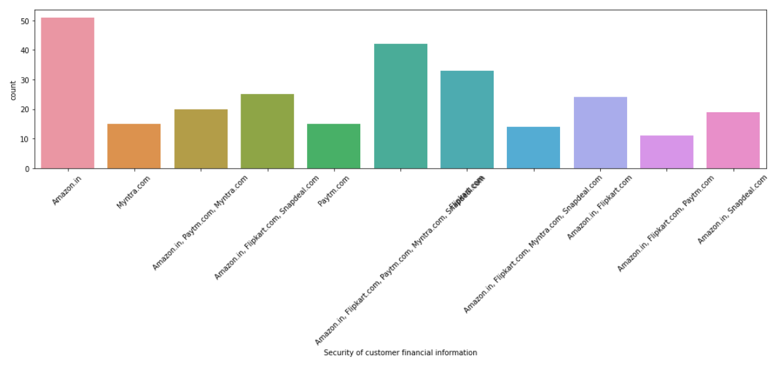
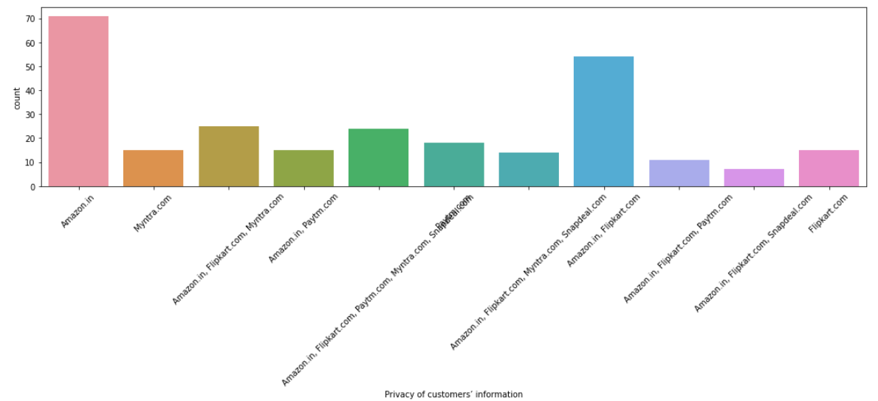
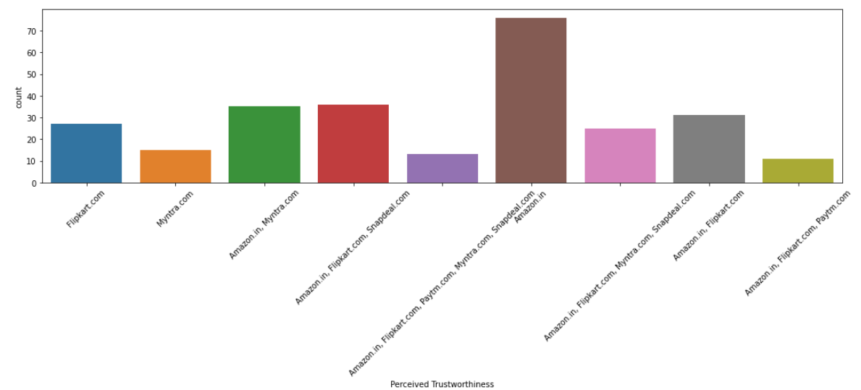

Slide 26
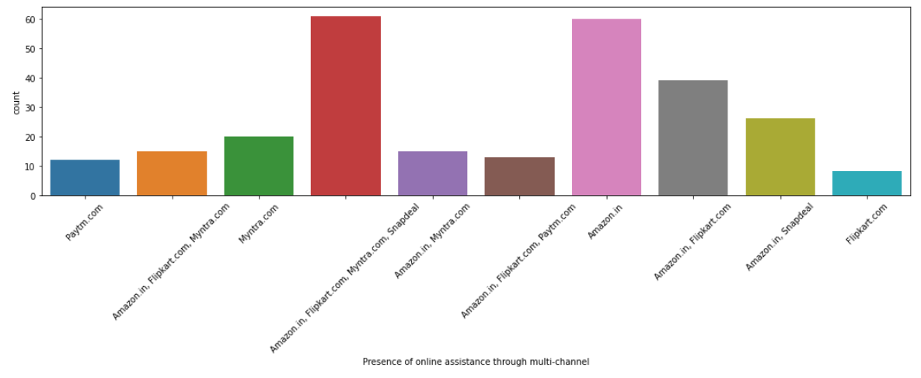
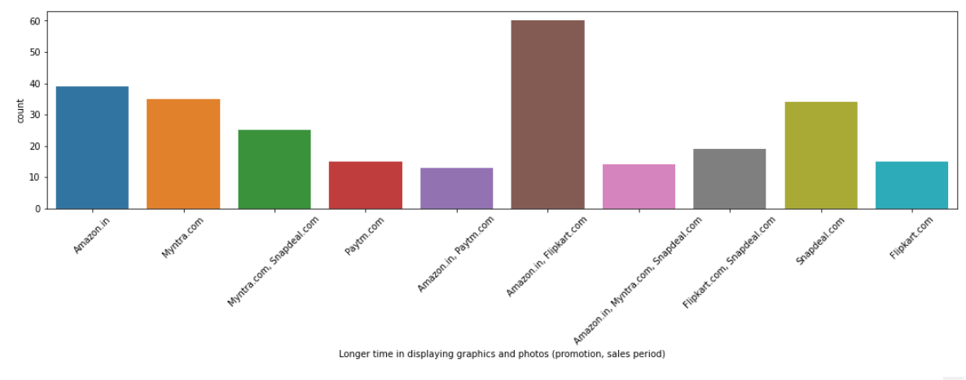
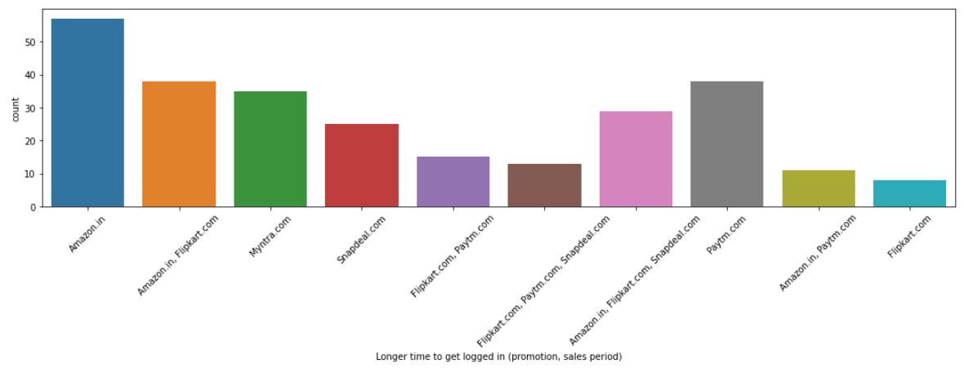
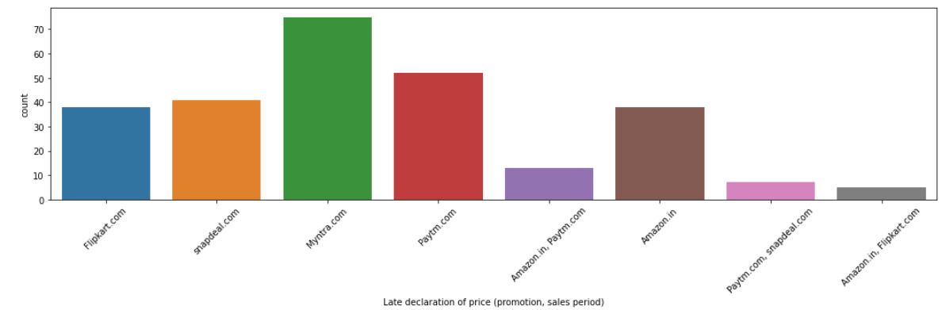

Slide 27
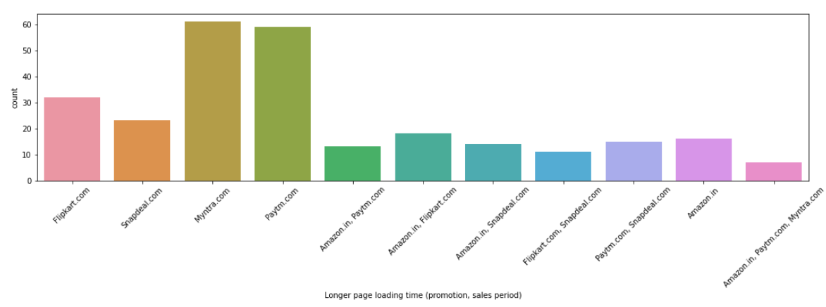
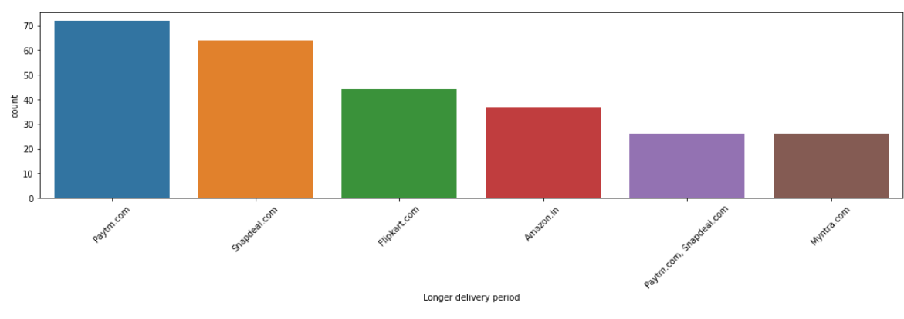
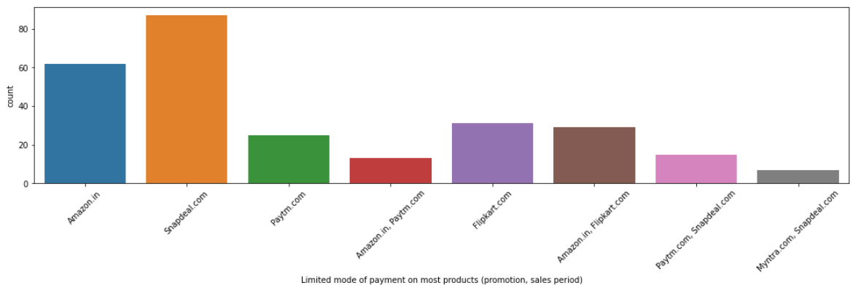
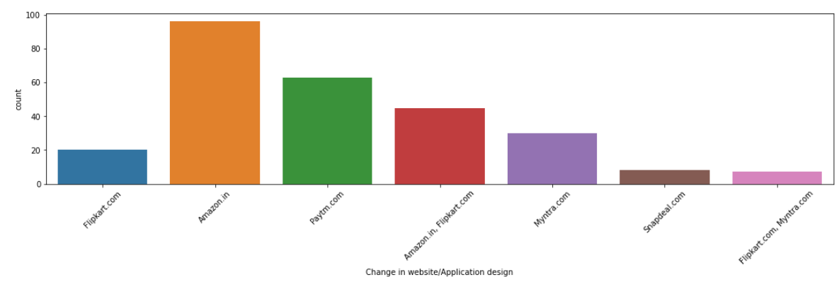

Slide 28
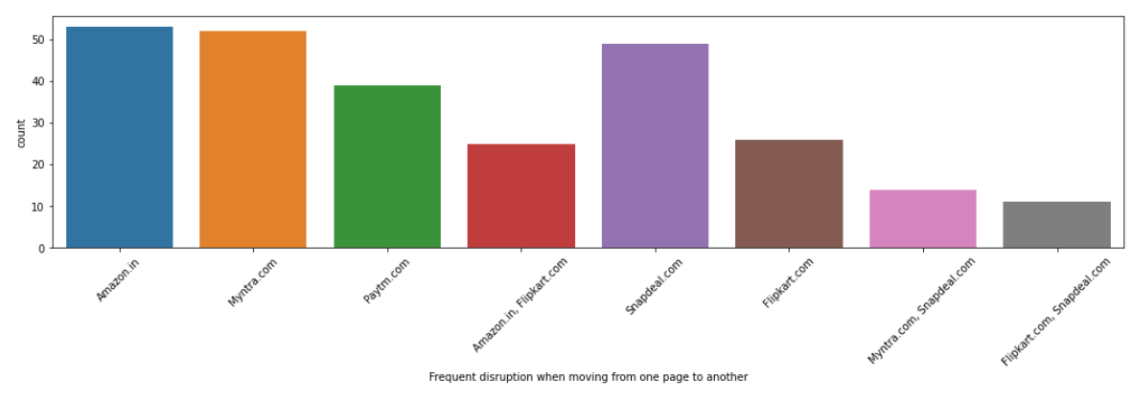
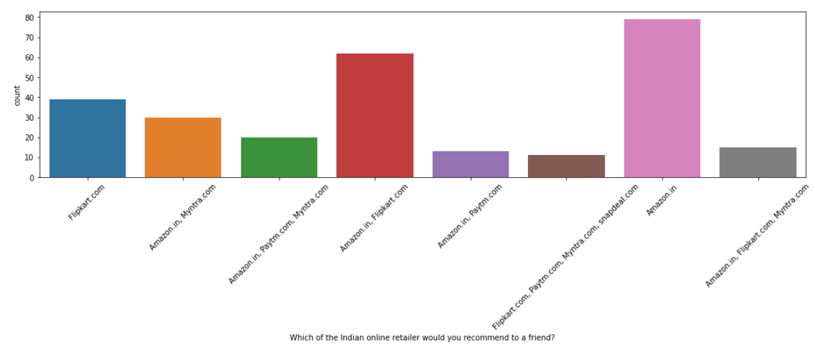
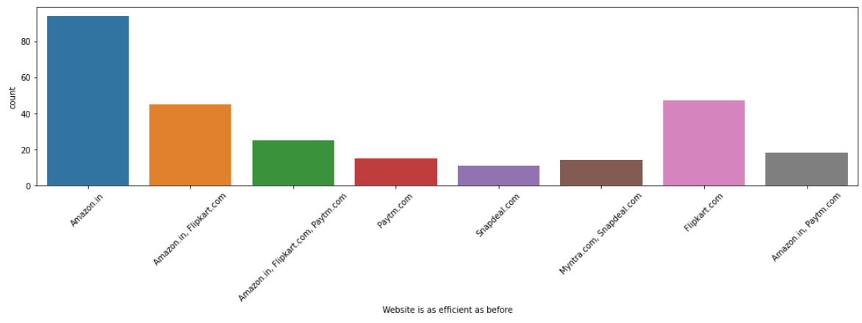

Slide 29
Observations :
Maximum people have shopped from these 5 companies - Amazon.in, Flipkart.com, Paytm.com, Myntra.com, Snapdeal.com.
Most people find Easy to use website or application are - Amazon.in, Flipkart.com, Paytm.com, Myntra.com, Snapdeal.com Also, Amazon.com and Flipkart.com are the major choices.
In terms of Visual appealing web-page layout also, Amazon.com and Flipkart.com seem to take the lead.
Talking about Wide variety of product on offer: Amazon.com and Flipkart.com are the major choices.
Complete, relevant description information of products: Once again, maximum people have chosen to go with mazon.com and Flipkart.com
Fast loading website speed of website and application: Amazon seems to take the lead in this category, although paytm and Flipkart are not far behind.
Reliability of the website or application: Amazon seems to take the lead in this category too, although Flipkart and paytm are not far behind.
Quickness to complete purchase: Amazon seems to take the lead in this category too, although Flipkart and paytm are not far behind.

Slide 30
Availability of several payment options: Here, Amazon and Flipkart, both are the favourites. Although a lot of people also tend to go towards Myntra
Speedy order delivery: Amazon seems to take the lead in this category too, followed by Flipkart.
Privacy of customers’ information: Amazon has a good reputation for maintaining privacy, followed by Flipkart
Security of customer financial information: Here other than Amazon and Flipkart, Paytm.com, Myntra.com, Snapdeal.com are also trusted by a lot of people. This shows that all compamnies pay special attention to security.
Perceived Trustworthiness: Amazon and Flipkart are winners here as well. Although Myntra.com and Snapdeal.com are also not far behind.
Presence of online assistance through multi-channel: Amazon.in, Flipkart.com, Myntra.com, Snapdeal
Longer time to get logged in (promotion, sales period): Amazon, paytm
Longer time in displaying graphics and photos (promotion, sales period): Amazon.in, Flipkart.com
Late declaration of price: Myntra, Paytm, Snapdeal. These companies should work on this area to improve.
Longer page loading time (promotion, sales period): Myntra and Paytm have bad feedback in this. Flipkart should also have a look into it, as it is at the 3rd place.
Limited mode of payment on most products (promotion, sales period): Snapdeal is the most voted answer for this.
Longer delivery period: Paytm and Snapdeal need to shorten their delivery time.
Change in website/Application design: Amazon.in
Frequent disruption when moving from one page to another: Amazon.in
Website is as efficient as before: Amazon.in
Which of the Indian online retailer would you recommend to a friend?: Amazon/Flipkart

Slide 31
Thank you

